Slide 1
IndiKit: Guidance on Humanitarian and Development Indicators
SPECIFY DATE | SPECIFY PRESENTER
Notes:
This presentation was prepared by People in Need (PIN) to help you with presenting IndiKit to your colleagues and partner organizations. Below each slide, you will find suggestions on what can you say about the given slide.
Introduce yourself and the presentation: “In this brief presentation I would like to introduce you to an M&E tool called IndiKit and explain how it can help you with your work.”

Slide 2
INTRODUCING INDIKIT
www.indikit.net is the most comprehensive online guidance on the use of humanitarian & development indicators across 24 topics
covers over 500 most commonly used indicators
guidance is based on existing standards (Sphere, UN agencies, donors)
aims to save aid workers’ time and contribute to better data quality
60,000 users annually, esp. from the Global South
developed in 2016 by People in Need (PIN)
available in English, Spanish, and Portuguese
Notes:
“IndiKit provides practical, easy-to-understand guidance on the use of the most commonly used project-level indicators across over 24 topics, such as XXXX [provide examples relevant to what people are interested in]. It is the most comprehensive online indicator guidance.”
“The website provides guidance on more than 500 most commonly used indicators.”
“The guidance is based on the existing standards and guidance provided by the Sphere Standards, various UN agencies, and donors”.
“IndiKit’s main aim is to 1) save aid workers’ time and 2) help them improve the quality of their M&E.”
“The website is visited annually by over 60,000 people - from the donor countries (e.g. USA and the UK) but especially from the regions affected by humanitarian crises or high levels of poverty, such as Eastern Africa and the Middle East.”
“IndiKit was developed in 2016 by the Czech humanitarian organization People in Need.”
“It is available in English, Portuguese, and thanks to the support of the organization Ayuda en Acción also in Spanish. The French version will be available in the year 2024.”

Slide 3
WHO CAN BENEFIT FROM INDIKIT?
people who write proposals
people who design MEAL frameworks
people who prepare surveys and analyse their data
IndiKit is a great tool for MEAL capacity building of partner organizations
Notes:
“Let’s now have a look at who can benefit the most from the support that IndiKit offers.”
“IndiKit is most useful for:
- people who write proposals, as they can easily find there indicators that they can use
- people who design MEAL frameworks, as IndiKit offers not only indicators but also guidance on how to use them
- people who prepare surveys and analyse their data, as for each indicator, IndiKit tells you how to collect the data (often it even provides specific survey questions) and how to analyse them
IndiKit can also be helpful when you work on increasing the MEAL capacities of your colleagues or partner organizations, as it provides lots of practical guidance.”

Slide 4
WHAT DOES INDIKIT OFFER?
wording of over 500 indicators
guidance on how to collect & analyse the required data
information on how to disaggregate the collected data
practical tips on what to consider / be careful about when using the indicator
links to additional guidance
Rapid Guides and MEAL checklists in multiple languages
sample size calculator
possibility to have your own version of IndiKit and customize it to your needs
Notes:
“Let’s now have a look at what exactly IndiKit offers:
- first of all, it provides the definitions of over 500 most commonly used indicators
- for each indicator, it gives you guidance on how to collect, analyse, and disaggregate the required data
- it gives very practical tips on what to be careful about when collecting or analysing the data – many of the tips are based on actual field experience
- it provides links to additional guidance in case you needed it
- it offers short guides and checklists on the main aspects of MEAL, such as on preparing surveys, doing individual interviews, describing survey methodology, disaggregating data, etc.
- and it also has a sample size calculator that can help you when doing quantitative surveys”
“IndiKit also offers organizations the possibility to have their own copy of the website with its own administration system that allows them to adjust the website’s content to the work they are doing.” [more info about this option is available here: https://www.indikit.net/news/6-do-you-want-your-own-version-of-indikit]

Slide 5
FAQs
How is IndiKit different from other indicator toolkits?
IndiKit has very practical guidance on all indicators, is comprehensive, and easy-to-use
Does IndiKit include donors’ indicators?
different donors use different indicators - it wouldn’t be user-friendly to list them all
instead, IndiKit provides guidance on the most commonly used indicators
How does IndiKit relate to the common humanitarian standards?
indicators are based on and recommend the use of common minimum standards
How was the guidance developed?
whenever possible, based on existing official guidance; if not available, based on MEAL and technical staff’s experience
new guidance as well as any changes are reviewed and validated by relevant specialists
Notes:
“Before I walk you through the actual website, I would like to answer some of the questions that people frequently ask about IndiKit.”
How is IndiKit different from other indicator toolkits?
“The main advantage of IndiKit is how practical it is – it covers only the most commonly used indicators and for each indicator it offers useful guidance that was developed based on official guidance and field experience. This makes it the most comprehensive indicator guidance that you can find online. You’ll also see that navigating the website is very easy, as from the beginning it was designed to be a very user-friendly website.”
Does IndiKit include donors’ indicators?
“IndiKit focuses on providing guidance on a limited selection of the most commonly used indicators, including some of those that are used by the main donors. However, it doesn’t list all the indicators that are used by the donors. This is because many of the donor indicators don’t require a guidance on their use (as they’re very simple). The second reason is that donors often use slightly different indicators, even when they concern the same topic, and including all their indicators would result it the website becoming not very user-friendly.”
How does IndiKit relate to the common humanitarian standards?
“The guidance presented on IndiKit is based on the existing standards and recommendations provided by the Sphere standards, UN agencies, Global Clusters, and other actors.”
How was the guidance developed?
“The website is being gradually developed since year 2016 by the staff of People in Need (PIN) and the collaborating external specialists (many of them do it voluntarily). First, PIN looks at what do organizations usually want to achieve when working on the given topic. Then they identify which indicators are already used to measure such achievements. If there aren’t many indicators available, PIN proposes new indicators, in collaboration with relevant experts. The next step is to develop the indicator guidance – whenever possible, already existing guidance and standards are used. If they are not available, then new guidance is developed and its quality is reviewed by relevant specialists.”

Slide 6
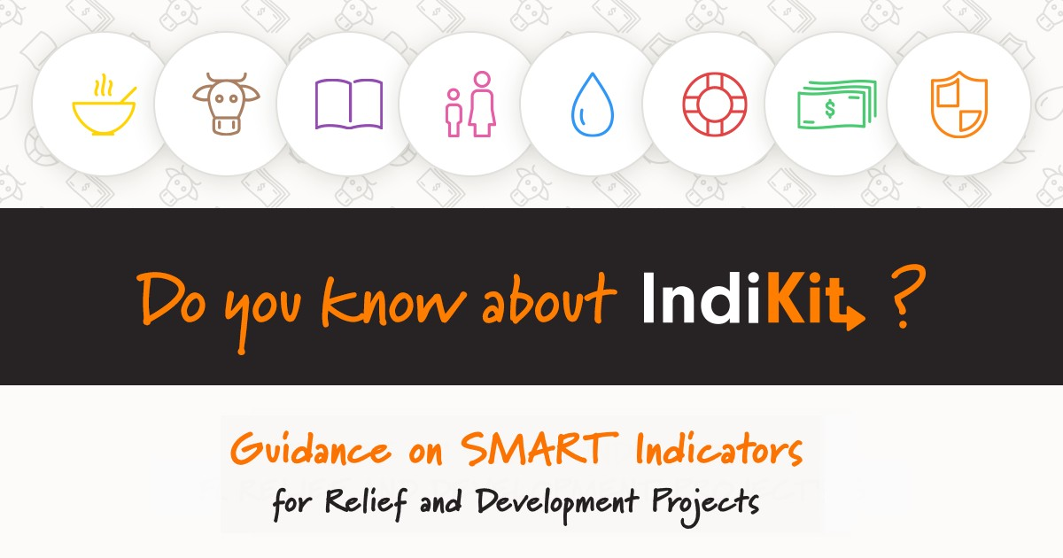
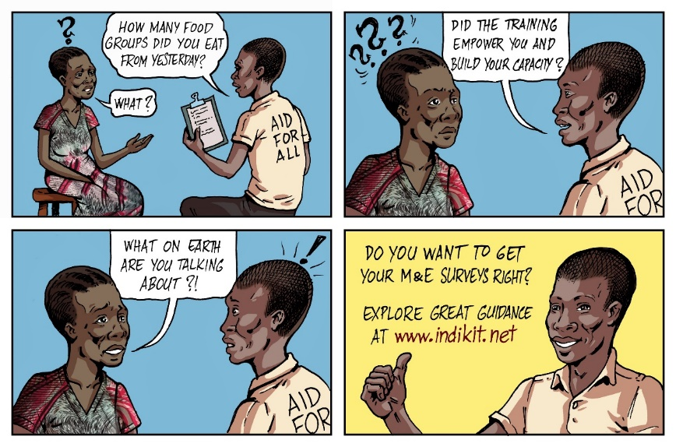
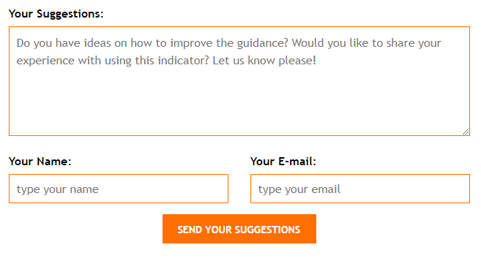
FAQs
How can I support IndiKit?
propose improvements using the feedback at the bottom of each indicator site
help with its promotion via social media (e.g. Linked) and emails
Notes:
“IndiKit is a resource that many people like and find useful and so they sometimes ask how can they support IndiKit. There are two main ways how you can support the website:
1) first, whenever you have some ideas on how some of the indicator guidance could be improved you can fill out the feedback form that is at the bottom of each site with the indicator guidance – this way, IndiKit is being improved based on the experience and expertise of its users
2) you can also promote IndiKit among other practitioners – you can send an email (a template of the text is available in the upper menu, under RESOURCES) or you can promote it on social media, such as LinkedIn, Twitter, or Facebook – you can use some of the banners that are available under RESOURCES”

Slide 7
Let's take a closer look at what IndiKit offers! www.indikit.net
Notes:
“Now let me walk you through the website so that you can see what IndiKit offers to you.”
Go to www.indikit.net and share your screen so that others can see the website.
Once you get to the homepage, show and explain briefly the following:
1) Two layers of the homepage – one with sectoral, second with crosscutting indicators.
2) In the upper right side of the website, people can switch the website to another language.
3) In the Sectoral section, you can click on “Nutrition” and then on indicator “Exclusive Breastfeeding Under Six Months” (note: you can choose any other indicator) and explain that for each indicator people can find:
- the first key information is the indicator’s wording in several languages
- what is the purpose of the indicator – what is it good for
- guidance on how to collect and analyse the data required for the indicator (sometimes including specific survey questions)
- suggestions on how the data should be disaggregated
- practical tips on what to be careful about and what to ensure when using the indicator
- additional resources on using the indicator
- if people have ideas on what could be improved or is missing, they can propose changes by using the form at the bottom of the site
4) Then, in the upper menu, click on “RESOURCES” and explain that at this site people can find materials for promoting IndiKit (these slides, banners for social media, email template, etc.), sample size calculator, brief M&E guides and checklists, links to additional resources. Then, click on “LINKS” (also in the upper menu) and explain that people can find here links to additional indicators used by various donors, institutions, etc.
5) On the right side of the screen, you should see a link YOUR INDIKIT (or “Do you want your own version of IndiKit?”). Show it to people, click on it, and say that this site explains how can organizations have their own version of IndiKit that is fully adjusted to their needs.
You can conclude it by saying: “You can see that with 2-3 clicks you can get most of the information you need – it is very easy.”

Slide 8
Do you have questions? Contact IndiKit!
Petr Schmied
IndiKit Manager petr.schmied@peopleinneed.net www.indikit.net
Notes:
Ask people for questions and comments.
At the end, encourage them to use and promote IndiKit. Tell them that if they need more information about IndiKit, they can contact IndiKit Manager.

